Slide 1

Databricks Academy An Introduction to Spark’s Architecture

Slide 2

Introduction to Spark’s Architecturerview
Overview
This course introduces the distributed programming paradigm of Spark
We will explore core concepts such as drivers & executors, clusters & nodes, parallelization, and scheduling
Having a good understanding of these concepts is critical to optimizing queries and troubleshooting performance issues

Slide 3
Introduction to Spark’s Architecturerview
Objectives
At the end of this course, you will be able to:
Identify and define the major components of Spark’s distributed architecture
Describe how applications are divided into jobs, stages, and tasks

Slide 4
Introduction to Spark’s Architecturerview
Key Concepts & Terms
This course also introduces the following concepts and terms:
Shared resources
Parallelization
Partitions
Jobs, Stages, and Tasks
Drivers
Executors
Clusters & Nodes
Slots/Cores/Threads

Slide 5
Introduction to Spark’s Architecturerview
Course Outline
This course is divided into three major sections:
Scenario #1: Filtering Distributed Computing
Scenario #2: Counting Stages
Scenario #3: Distinct The Shuffle

Slide 6
Databricks Academy An Introduction to Spark’s Architecture Scenario #1, Part 1a: Filtering (Key Concept: Distributed Computing)

Slide 7

Everything I learned about Spark...
Notes:
The first thing we want to do with the data is pretty simple - filter out all of the brown candies.

Slide 8
Everything I learned about Spark...
I hate the brown D&Bs
Notes:
The first thing we want to do with the data is pretty simple - filter out all of the brown candies.

Slide 9
Everything I learned about Spark...
Can you grab the bag...
Notes:
The first thing we want to do with the data is pretty simple - filter out all of the brown candies.

Slide 10
... open the bag...
d&b
d&b
d&b
d&b
d&b
d&b
d&b
d&b
d&b
d&b
d&b
d&b
d&b
d&b
d&b
d&b

Slide 11
Everything I learned about Spark...
... and eat all the brown D&Bs...
d&b
d&b
d&b
d&b
d&b
d&b
d&b
d&b
d&b
d&b
d&b
d&b
d&b
d&b
d&b
d&b

Slide 12

Everything I learned about Spark...
... in only 60 seconds?
d&b
d&b
d&b
d&b
d&b
d&b
d&b
d&b
d&b
d&b
d&b
d&b
d&b
d&b
d&b
d&b
60
Notes:
Can you do that in 30 seconds? It's definitely possible to quickly go up to the pile, bring back the bag to your desk, open it, separate the brown ones, then eat - that is, filter - them. However that might be a reasonable amount of time to guarantee. It's possible to do it quicker still, but we're looking for a reliable time for that task.

Slide 13

Everything I learned about Spark...
How about 100 bags of D&Bs within 60 seconds?
60

Slide 14
Everything I learned about Spark...
Can you solve this problem?
What resources do you have?
What resources do you need?
60
Notes:
A single bag of candies doesn't present that much of a challenge. A single person can easily process it in a reasonable amount of time. But what if we had a lot more data? Many, many bags? Welcome to the era of Big Candy.
Can you do all of the steps above with all of the bags of candies? Almost definitely not by yourself in the same reasonable time frame. However, if we coordinate the entire class in the operation, we can very quickly filter (eat) all of the brown candies in this pile.

Slide 15
Databricks Academy An Introduction to Spark’s Architecture Scenario #1, Part 1b: Filtering (Key Concept: Distributed Computing)

Slide 16


Where do we start?
Notes:
Instructor Notes
Point #1
Point #2
Script Let's take a look at how we might do this in parallel for several different questions about our candies.

Slide 17
Let’s assume that each student can grab, open, and process a small bag
Notes:
Let's take a look at how we might do this in parallel for several different questions about our candies.

Slide 18
First subdivide the large bag of D&Bs into, smaller, more manageable bags
Notes:
Let's take a look at how we might do this in parallel for several different questions about our candies.

Slide 19
5
6
13
14
15
7
8
1
16
Assign each bag a unique number, or ID
2
3
4
9
10
11
12
Notes:
Let's take a look at how we might do this in parallel for several different questions about our candies.

Slide 20
























Assign each student a unique letter, or ID
Notes:
Let's take a look at how we might do this in parallel for several different questions about our candies.

Slide 21
Student A gets bag #2...
Student B gets bag #3...
Student C gets bag #6...
and so on...
Notes:
Let's take a look at how we might do this in parallel for several different questions about our candies.

Slide 22
Instructions: Eat all the brown D&Bs and pile the rest in the corner.
Notes:
Let's take a look at how we might do this in parallel for several different questions about our candies.

Slide 23
Ready…
Set…
Go!
C
Notes:
Let's take a look at how we might do this in parallel for several different questions about our candies.

Slide 24
Some students are faster than others…
And yet others are a slower than the some...
d&b
d&b
d&b
d&b
d&b
d&b
d&b
d&b
d&b
d&b
d&b
d&b
d&b
d&b
d&b
d&b
d&b
d&b
d&b
d&b
Notes:
Let's take a look at how we might do this in parallel for several different questions about our candies.

Slide 25
…everybody just works at their own pace…
d&b
d&b
d&b
d&b
d&b
d&b
d&b
d&b
d&b
d&b
d&b
d&b
d&b
d&b
d&b
d&b
d&b
d&b
d&b
d&b
d&b
d&b
d&b
d&b
d&b
d&b
d&b
d&b
d&b
d&b
d&b
d&b
d&b
d&b
d&b
d&b
d&b
d&b
d&b
d&b
d&b
d&b
d&b
d&b
d&b
d&b
d&b
d&b
d&b
d&b
d&b
d&b
d&b
d&b
d&b
d&b
d&b
d&b
d&b
d&b
d&b
d&b
d&b
d&b
d&b
d&b
d&b
d&b
d&b
d&b
d&b
d&b
d&b
d&b
d&b
Notes:
Let's take a look at how we might do this in parallel for several different questions about our candies.

Slide 26
4 of our students
are idle again…
d&b
d&b
d&b
d&b
d&b
d&b
d&b
d&b
d&b
d&b
d&b
d&b
d&b
d&b
d&b
d&b
d&b
d&b
d&b
d&b
d&b
d&b
d&b
d&b
d&b
d&b
d&b
d&b
d&b
d&b
d&b
d&b
d&b
d&b
d&b
d&b
d&b
d&b
d&b
d&b
d&b
d&b
d&b
d&b
d&b
d&b
d&b
d&b
d&b
d&b
d&b
d&b
d&b
d&b
d&b
Notes:
Let's take a look at how we might do this in parallel for several different questions about our candies.

Slide 27
5
8
They need new tasks!
1
Students A, E, H, & J, grab bags #1, #4, #5, & #8
d&b
d&b
d&b
d&b
d&b
4
d&b
d&b
d&b
d&b
d&b
d&b
d&b
d&b
d&b
d&b
d&b
d&b
d&b
d&b
d&b
d&b
d&b
d&b
d&b
d&b
d&b
d&b
d&b
d&b
d&b
d&b
d&b
d&b
d&b
d&b
d&b
d&b
d&b
d&b
d&b
d&b
d&b
d&b
d&b
d&b
d&b
d&b
d&b
d&b
d&b
d&b
d&b
d&b
d&b
d&b
Notes:
Let's take a look at how we might do this in parallel for several different questions about our candies.

Slide 28
And so they just keep working…
…and working…
…and working…
d&b
d&b
d&b
d&b
d&b
d&b
d&b
d&b
d&b
d&b
d&b
d&b
d&b
d&b
d&b
d&b
d&b
d&b
d&b
d&b
d&b
d&b
d&b
d&b
d&b
d&b
d&b
d&b
d&b
d&b
d&b
d&b
d&b
d&b
d&b
d&b
d&b
d&b
d&b
d&b
d&b
d&b
d&b
d&b
d&b
d&b
d&b
d&b
d&b
d&b
d&b
d&b
d&b
d&b
d&b
d&b
d&b
d&b
d&b
d&b
d&b
d&b
d&b
d&b
d&b
d&b
d&b
d&b
d&b
d&b
d&b
d&b
d&b
d&b
d&b
d&b
d&b
d&b
d&b
d&b
d&b
d&b
d&b
d&b
d&b
d&b
d&b
d&b
d&b
d&b
d&b
d&b
d&b
d&b
d&b
d&b
d&b
d&b
d&b
d&b
Notes:
Let's take a look at how we might do this in parallel for several different questions about our candies.

Slide 29
…and working…
d&b
d&b
d&b
All Done!
d&b
d&b
d&b
d&b
d&b
d&b
d&b
d&b
d&b
d&b
d&b
d&b
d&b
d&b
d&b
d&b
d&b
d&b
d&b
d&b
d&b
d&b
d&b
d&b
d&b
d&b
d&b
d&b
d&b
d&b
d&b
d&b
d&b
d&b
d&b
d&b
d&b
d&b
d&b
d&b
d&b
d&b
d&b
d&b
d&b
d&b
d&b
d&b
d&b
d&b
d&b
d&b
d&b
d&b
d&b
d&b
d&b
d&b
d&b
d&b
d&b
d&b
d&b
d&b
d&b
d&b
d&b
d&b
d&b
d&b
d&b
d&b
d&b
d&b
d&b
d&b
d&b
d&b
d&b
d&b
d&b
d&b
d&b
d&b
d&b
d&b
d&b
d&b
d&b
d&b
d&b
d&b
d&b
d&b
d&b
d&b
d&b
Notes:
Let's take a look at how we might do this in parallel for several different questions about our candies.

Slide 30
Introduction to Spark’s Architecturerview
Spark Architecture Concepts
Driver
Executors
Clusters & Nodes
Slots/Cores/Threads
Shared resources
Parallelization
Partitions
Jobs, Stages, and Tasks

Slide 31
Databricks Academy An Introduction to Spark’s Architecture Scenario #1, Part 2: Filtering (Key Concept: Distributed Computing)

Slide 32
Driver
d&b
d&b
d&b
d&b
d&b
d&b
d&b
d&b
d&b
d&b
d&b
d&b
d&b
d&b
d&b
d&b
d&b
d&b
d&b
d&b
Notes:
Let's take a look at how we might do this in parallel for several different questions about our candies.

Slide 33
Driver
Executors
d&b
d&b
d&b
d&b
d&b
d&b
d&b
d&b
d&b
d&b
d&b
d&b
d&b
d&b
d&b
d&b
d&b
d&b
d&b
d&b
Notes:
Let's take a look at how we might do this in parallel for several different questions about our candies.

Slide 34
Spark Cluster
Driver
Executors
d&b
d&b
d&b
d&b
d&b
d&b
d&b
d&b
d&b
d&b
F
d&b
d&b
d&b
d&b
d&b
d&b
d&b
d&b
d&b
d&b
I
Notes:
Let's take a look at how we might do this in parallel for several different questions about our candies.

Slide 35
Systems like YARN will at times run multiple executors in a single node
Spark Cluster
Nodes
d&b
d&b
d&b
d&b
d&b
d&b
d&b
d&b
d&b
d&b
d&b
d&b
d&b
d&b
d&b
d&b
d&b
d&b
d&b
d&b
Notes:
Let's take a look at how we might do this in parallel for several different questions about our candies.

Slide 36
Databricks however, runs one executor per node
Spark Cluster
Nodes
d&b
d&b
d&b
d&b
d&b
d&b
d&b
d&b
d&b
d&b
d&b
d&b
d&b
d&b
d&b
d&b
d&b
d&b
d&b
d&b
Notes:
Let's take a look at how we might do this in parallel for several different questions about our candies.

Slide 37
Nodes
d&b
d&b
d&b
d&b
d&b
Slots / Threads / Cores
(interchangeable terms)
d&b
d&b
d&b
d&b
d&b
Notes:
Let's take a look at how we might do this in parallel for several different questions about our candies.

Slide 38
Nodes
d&b
d&b
d&b
d&b
d&b
Shared Resources
(RAM, Disk, Network)
d&b
d&b
d&b
d&b
d&b
Notes:
Let's take a look at how we might do this in parallel for several different questions about our candies.

Slide 39
Maximum Parallelization: 12 Tasks
(6 executors, 2 cores each)
d&b
d&b
d&b
d&b
d&b
d&b
d&b
d&b
d&b
d&b
d&b
d&b
d&b
d&b
d&b
d&b
d&b
d&b
d&b
d&b
Notes:
Let's take a look at how we might do this in parallel for several different questions about our candies.

Slide 40
Dataset
d&b
d&b
d&b
d&b
d&b
d&b
d&b
d&b
d&b
d&b
d&b
d&b
d&b
d&b
d&b
d&b
d&b
d&b
d&b
d&b
Notes:
Let's take a look at how we might do this in parallel for several different questions about our candies.

Slide 41
Partitions
d&b
d&b
d&b
d&b
d&b
d&b
d&b
d&b
d&b
d&b
d&b
d&b
d&b
d&b
d&b
d&b
d&b
d&b
d&b
d&b
Notes:
Let's take a look at how we might do this in parallel for several different questions about our candies.

Slide 42
Instructions: Eliminate all the brown candies and pile the rest in the corner.
A Spark Job
(with only 1 stage)
d&b
d&b
d&b
d&b
d&b
d&b
d&b
d&b
d&b
d&b
d&b
d&b
d&b
d&b
d&b
d&b
d&b
d&b
d&b
d&b
Notes:
Let's take a look at how we might do this in parallel for several different questions about our candies.

Slide 43
Databricks Academy An Introduction to Spark’s Architecture Scenario #1, Part 3: Review Questions (Key Concept: Distributed Computing)

Slide 44
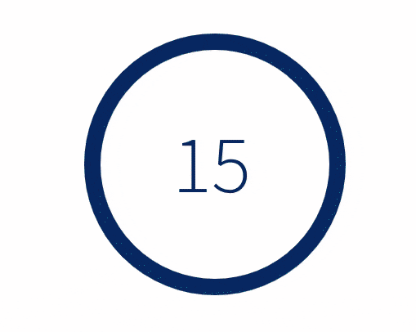
What is the relationship between applications, jobs, stages, and tasks?
Applications consists of zero or more jobs
Jobs consists of one or more stages
Stages consists of one or more tasks
Tasks are a single unit of work against a single partition of data

Slide 45
How does each task know which piece of data to process?
The driver assigns one and only one partition of data to each task and in turn, dictates that the task be executed in a specific slot
Notes:
The Driver assigns partitions of data (bags of candies) to each Task

Slide 46
If I have 3 executors and each executor has 3 slots, how many tasks can be executed in parallel?
Answer: 3 * 3 = 9
Notes:
Let's take a look at how we might do this in parallel for several different questions about our candies.

Slide 47
Which component decides how to partition the dataset so it can be distributed for parallel processing?
The driver
d&b
d&b
d&b
d&b
d&b
d&b
d&b
d&b
d&b
d&b
d&b
d&b
d&b
d&b
d&b
d&b
d&b
d&b
d&b
d&b
Notes:
Let's take a look at how we might do this in parallel for several different questions about our candies.

Slide 48
What is the term for the lowest unit of work in a Spark job?
d&b
d&b
d&b
d&b
d&b
d&b
d&b
d&b
d&b
d&b
d&b
d&b
d&b
d&b
d&b
d&b
d&b
d&b
d&b
d&b
d&b
d&b
d&b
d&b
d&b
d&b
d&b
d&b
d&b
d&b
A task
(executed by a slot)
d&b
d&b
d&b
d&b
d&b
d&b
d&b
d&b
d&b
d&b
Notes:
Let's take a look at how we might do this in parallel for several different questions about our candies.

Slide 49
In what environment is a task executed in?
The executor
(a Java Virtual Machine or JVM)
d&b
d&b
d&b
d&b
d&b
d&b
d&b
d&b
d&b
d&b
d&b
d&b
d&b
d&b
d&b
d&b
d&b
d&b
d&b
d&b
Notes:
We want to make sure that each of the bags are close to the same size to balance our cluster (so we don't have a lot of wasted idle resources), and we want to have one bag per processing core (executor task) at a time. If one person got a giant-sized bag while everyone else got a mini-bag, our candy counting would be skewed. All of the mini-bag counters would have to wait for the giant-bag counter to finish to go to another stage or deliver final results to the instructor.

Slide 50
Databricks Academy An Introduction to Spark’s Architecture Scenario #1, Part 4: Recap (Key Concept: Distributed Computing)

Slide 51

An Introduction to Spark’s Architecture
Recap
Spark Architecture Concepts: Recap
Clusters and Nodes
A Cluster is a group of nodes
Nodes are the individual machines within a cluster (generally a VM)
With Databricks, the driver (a JVM) and each executor (each a JVM) all run in their own nodes

Slide 52

An Introduction to Spark’s Architecture
Spark Architecture Concepts: Recap
Driver
Runs the Spark application
Assigns tasks to slots in an executor
Coordinates the work between tasks
Receives the results, if any

Slide 53

An Introduction to Spark’s Architecture
Spark Architecture Concepts: Recap
Executors
Provides an environment in which tasks can be run
Leverages the JVM to execute many threads

Slide 54

An Introduction to Spark’s Architecture
Spark Architecture Concepts: Recap
Slots/Cores/Threads
The lowest unit of parallelization
Generally interchangeable terms, but “slot” is the most accurate term
Executes a set of transformations against a partition as directed to by the driver

Slide 55
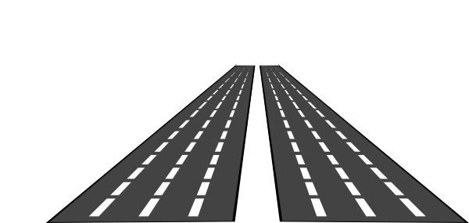
An Introduction to Spark’s Architecture
Spark Architecture Concepts: Recap
Parallelization
Scale horizontally by adding more executors
Scale vertically by adding cores to each executor

Slide 56

An Introduction to Spark’s Architecture
Spark Architecture Concepts: Recap
Partitions
A ~128 MB chunk of the larger dataset
Each task processes one and only one partition
The size and record splits are decided by the driver
The initial size is partially adjustable with various configuration options

Slide 57

An Introduction to Spark’s Architecture
Spark Architecture Concepts: Recap
Applications, Jobs, Stages, and Tasks
The hierarchy into which work is subdivided
One Spark action results in one or more jobs
The number of stages depends on the operations submitted with the application
Tasks are the smallest unit of work

Slide 58

An Introduction to Spark’s Architecture
Spark Architecture Concepts: Recap
General Notes
Executors share machine level resources
Tasks share executor (JVM) level resources
Rarely are significant performance improvements made by tweaking Spark configuration settings

Slide 59
Databricks Academy An Introduction to Spark’s Architecture Scenario #2: Counting (Key Concept: Stages)

Slide 60
How would I go about counting all of the D&Bs?
Notes:
Let's take a look at how we might do this in parallel for several different questions about our candies.

Slide 61
Databricks Academy An Introduction to Spark’s Architecture Scenario #2, Part 1: The Local Count (Key Concept: Stages)

Slide 62
Stage #1: Local Count
Student A, grab & count bag #1.
Student D, grab & count bag #2.
Student I, grab & count bag #3.
Student J, grab & count bag #4.
2
3
1
4
Notes:
Let's take a look at how we might do this in parallel for several different questions about our candies.

Slide 63
Stage #1: Local Count
Each student is fetching their partition of D&Bs
Notes:
Let's take a look at how we might do this in parallel for several different questions about our candies.

Slide 64
Stage #1: Local Count
I think J is stuck… I can’t continue, now! What should I do?
Are you there?
Yo J…
d&b
d&b
d&b
d&b
d&b
d&b
d&b
d&b
d&b
d&b
d&b
d&b
d&b
d&b
d&b
Notes:
Let's take a look at how we might do this in parallel for several different questions about our candies.

Slide 65
Stage #1: Local Count
Stage #1: Local Count
I can cancel J’s task and retry it in another slot
d&b
d&b
d&b
d&b
d&b
d&b
d&b
d&b
d&b
d&b
d&b
d&b
d&b
d&b
d&b
Notes:
Let's take a look at how we might do this in parallel for several different questions about our candies.

Slide 66
Stage #1: Local Count
Stage #1: Local Count
…or I can let J keep running, respawn the task with K, and speculate that K will finish first!
d&b
d&b
d&b
d&b
d&b
d&b
d&b
d&b
d&b
d&b
d&b
d&b
d&b
d&b
d&b
Notes:
Let's take a look at how we might do this in parallel for several different questions about our candies.

Slide 67
Stage #1: Local Count
Student K, grab and count bag #4.
d&b
d&b
d&b
d&b
d&b
d&b
d&b
d&b
d&b
d&b
d&b
d&b
d&b
d&b
d&b
Notes:
Let's take a look at how we might do this in parallel for several different questions about our candies.

Slide 68
Stage #1: Local Count
I’ll settle for the results of Student J or Student K… Whomever finishes first.
And… Student K finished first! Cancel J’s task
d&b
d&b
d&b
?
d&b
d&b
d&b
d&b
d&b
!
d&b
d&b
d&b
d&b
d&b
d&b
d&b
d&b
d&b
d&b
d&b
d&b
Notes:
Let's take a look at how we might do this in parallel for several different questions about our candies.

Slide 69
Stage #1: Local Count
Stage #1: Local Count
Each task is counting their set of D&Bs
5
4
d&b
d&b
d&b
d&b
d&b
d&b
d&b
d&b
d&b
d&b
5
6
d&b
d&b
d&b
d&b
d&b
d&b
d&b
d&b
d&b
d&b
Notes:
Let's take a look at how we might do this in parallel for several different questions about our candies.

Slide 70
Stage #1: Local Count
A, D, I & K persist their totals for later
Okay, stage #1 is done
5
4
5
4
5
6
5
6
Notes:
Let's take a look at how we might do this in parallel for several different questions about our candies.

Slide 71
Databricks Academy An Introduction to Spark’s Architecture Scenario #2, Part 2: The Global Count (Key Concept: Distributed Computing)

Slide 72
Stage #2: Global Count
Student F, fetch the counts from Students A, D, I & K
6
5
4
5
5
4
5
6
Notes:
Let's take a look at how we might do this in parallel for several different questions about our candies.

Slide 73
Stage #2: Global Count
…sum up the individual counts…
6
5
5
20
4
Notes:
Let's take a look at how we might do this in parallel for several different questions about our candies.

Slide 74
Stage #2: Global Count
Return the results to the driver
Okay, stage #2 is done
20
20
Notes:
Let's take a look at how we might do this in parallel for several different questions about our candies.

Slide 75
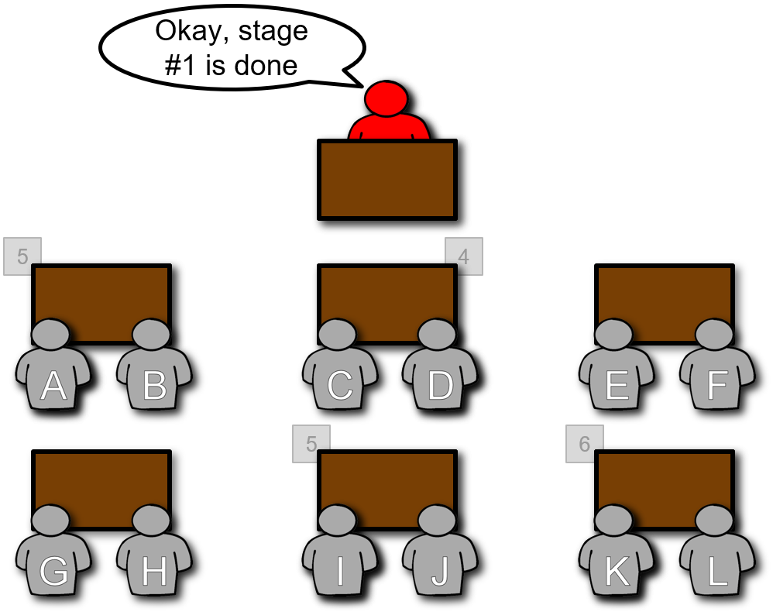
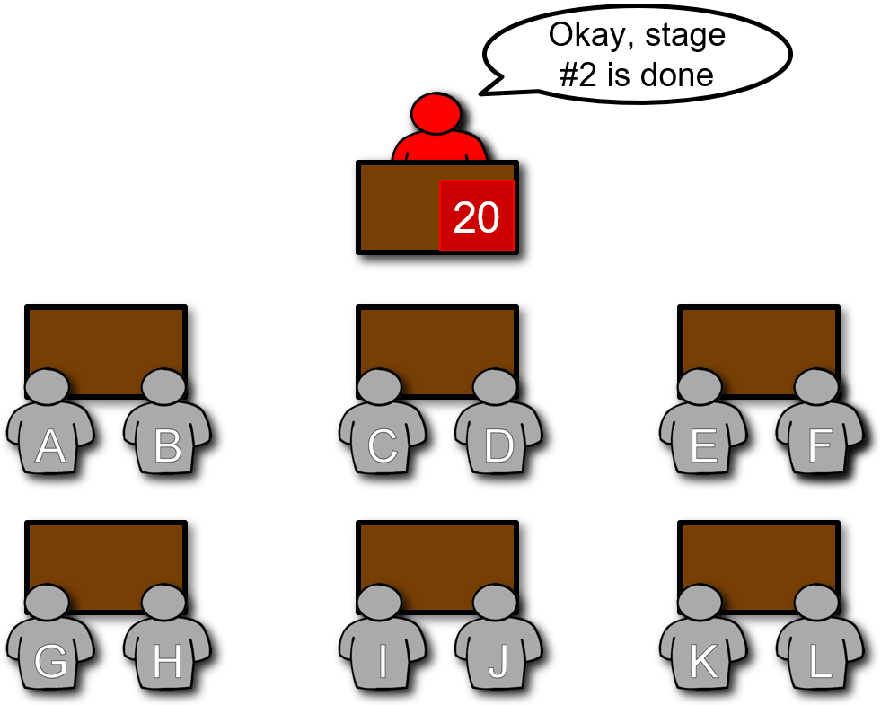
Spark Architecture Concept: Stages
Stage #1: Local Count
Stage #2: Global Count
Notes:
Let's take a look at how we might do this in parallel for several different questions about our candies.

Slide 76
The Local & Global Results
Stage #1
Local Filter
Local Count
Stage #2
Global Filter
Global Count
Notes:
Let's take a look at how we might do this in parallel for several different questions about our candies.

Slide 77
The Local & Global Results
Stage #1
Local Filter
Local Count
Local Distinct
Stage #2
Global Filter
Global Count
Global Distinct
Notes:
Let's take a look at how we might do this in parallel for several different questions about our candies.

Slide 78
The Local & Global Results
Stage #1
Local Filter
Local Count
Local Distinct
Local Sort
Stage #2
Global Filter
Global Count
Global Distinct
Global Sort
Notes:
Let's take a look at how we might do this in parallel for several different questions about our candies.

Slide 79
The Local & Global Results
Stage #1
Local Filter
Local Count
Local Distinct
Local Sort
Local Aggregate
Stage #2
Global Filter
Global Count
Global Distinct
Global Sort
Global Aggregate
Notes:
Let's take a look at how we might do this in parallel for several different questions about our candies.

Slide 80
Databricks Academy An Introduction to Spark’s Architecture Scenario #2, Part 3: Review Questions (Key Concept: Distributed Computing)

Slide 81
What were the jobs, stages, and tasks in this scenario?
How would I go about counting all of the D&Bs?
The job was to count the D&Bs
Stage #1 was the local count
Stage #2 was the global count
The tasks were first to count each D&B in stage #1, and later to aggregate & sum the individual counts in stage #2
Notes:
Let's take a look at how we might do this in parallel for several different questions about our candies.

Slide 82
Spark can optimize execution by combining multiple, narrow, transformations into a single stage
These narrow transformations can all be executed against the same partition of data
Why does Spark perform
operations in stages?
Wide transformations induce a stage boundary because they require data from many partitions
Between the two stages, data is reorganized throughout the entire cluster via the process of shuffling

Slide 83
At the end of stage #2, the final count was returned to the driver. The final stage of every job varies.
What happened at the end of each stage of this scenario?
At the end of stage #1, the local counts were written to shuffle files to be read in by stage #2
The last stage of all Spark jobs end the same way – by writing the results to shuffle files for the next stage

Slide 84
No
In order to properly shuffle the data, Spark needs all the tasks producing the to-be-shuffled data to be completed
Can tasks in stage #2 be started before tasks in stage #1 are complete?
Spark 3 introduced an exception to this - where it is clear to Spark that two stages are not dependent on each other such as processing the left and right side of a join

Slide 85
The entire stage is delayed because all tasks must be completed before the stage can be completed
What would happen if a single task is taking significantly longer than every other task?
This happens frequently when one partition has more records than any other partition – commonly called skew
Spark can cancel and retry the task or if spark.speculation is enabled (disabled by default) it can launch a second instance and wait for one of the two tasks to complete

Slide 86
Databricks Academy An Introduction to Spark’s Architecture Scenario #2, Part 4: Recap (Key Concept: Distributed Computing)

Slide 87

Introduction to Spark’s Architecturerview
Spark Architecture Concepts: Recap
Stages
A stage cannot be completed until all tasks are completed
Spark 3.x can run some stages in parallel (e.g. inputs to a join)
One long-running task can delay an entire stage from completing
The shuffle between two stages is one of the most expensive operations in Apache Spark

Slide 88
Databricks Academy An Introduction to Spark’s Architecture Scenario #3: Distinct (Key Concept: The Shuffle)

Slide 89
Between the Christmas, Halloween and Valentine D&Bs, how many distinct colors are there?
Notes:
Let's take a look at how we might do this in parallel for several different questions about our candies.

Slide 90
Databricks Academy An Introduction to Spark’s Architecture Scenario #3, Part 1: Local Distinct (Key Concept: The Shuffle)

Slide 91
Stage #1: Local Distinct
Student A, grab & count bag #1.
Student D, grab & count bag #2.
Student I, grab & count bag #3.
Student J, grab & count bag #4.
3
4
2
1
Notes:
Let's take a look at how we might do this in parallel for several different questions about our candies.

Slide 92
Stage #1: Local Distinct
Each student is fetching their partition of D&Bs
Notes:
Let's take a look at how we might do this in parallel for several different questions about our candies.

Slide 93
Stage #1: Local Distinct
Each task is being processed…
d&b
d&b
d&b
d&b
d&b
d&b
d&b
d&b
d&b
d&b
d&b
d&b
d&b
d&b
d&b
d&b
d&b
d&b
d&b
d&b
Notes:
Let's take a look at how we might do this in parallel for several different questions about our candies.

Slide 94
Stage #1: Local Distinct
…and identifying the distinct set of colors.
Okay, stage #1 is done
Orange
Blue
Yellow
Pink
Green
White
Red
d&b
d&b
d&b
d&b
d&b
d&b
d&b
d&b
d&b
d&b
Red
Green
Orange
Red
d&b
d&b
d&b
d&b
Black
d&b
d&b
d&b
d&b
d&b
d&b
Notes:
Let's take a look at how we might do this in parallel for several different questions about our candies.

Slide 95
Databricks Academy An Introduction to Spark’s Architecture Scenario #3, Part 2: A Conceptual Shuffle (Key Concept: The Shuffle)

Slide 96
The Shuffle (Conceptual)
…relocate all the records by key (aka color).
Orange
Blue
Yellow
Pink
Green
White
Red
Red
Green
Orange
Red
Black
Notes:
Let's take a look at how we might do this in parallel for several different questions about our candies.

Slide 97
Databricks Academy An Introduction to Spark’s Architecture Scenario #3, Part 3: Global Distinct (Key Concept: The Shuffle)

Slide 98
Stage #2: Global Distinct
…read in each shuffle file from the remote executors…
Orange
Orange
Blue
Yellow
Pink
Green
White
Red
Red
Red
Green
Red
Green
Red
Orange
Red
Black
Yellow
Notes:
Let's take a look at how we might do this in parallel for several different questions about our candies.

Slide 99
Stage #2: Global Distinct
…reduce the duplicates to a single record per color…
Orange
Orange
Blue
Pink
White
Red
Green
Red
Green
Red
Orange
Red
Black
Yellow
Notes:
Let's take a look at how we might do this in parallel for several different questions about our candies.

Slide 100
Stage #2: Global Distinct
…just one more narrow transformation…
Pink
Orange
#FF00FF
#FF9900
White
Blue
#FFFFFF
#0000FF
Red
Green
#FF0000
#00FE00
Yellow
Black
#FEFE00
#000000
Notes:
Let's take a look at how we might do this in parallel for several different questions about our candies.

Slide 101
Stage #2: Global Distinct
…now they only need to return the results…
Okay, stage #2 is done
#FF9900
#FF00FF
#0000FF
#FFFFFF
#00FE00
#FF0000
#FEFE00
#000000
Notes:
Let's take a look at how we might do this in parallel for several different questions about our candies.

Slide 102
Spark Architecture Concept: Shuffles
Stage #1: Local Distinct
Stage #2: Global Distinct
Notes:
Let's take a look at how we might do this in parallel for several different questions about our candies.

Slide 103
Databricks Academy An Introduction to Spark’s Architecture Scenario #3, Part 4: Review Questions (Key Concept: The Shuffle)

Slide 104
Each task is only capable of producing a distinct set of colors from its local partition of data
Why is a shuffle triggered
at the end of Stage 1?
Recall that three tasks produced new partitions including the color red – locally distinct, but not globally distinct
During the shuffle, the three instances of the color red were reduced to a single instance of the color red

Slide 105
In the 1st half of the shuffle, the data has to be converted to a new format and written to a shuffle file
Why is the shuffle an expensive
operation for Apache Spark?
In the 2nd half, the data has to be read from a remote node which includes reading the data back from disk
All the extra disk and network IO has a cumulative cost
Notes:
The Shuffle is an expensive operation since it involves disk I/O, data serialization, and network I/O. To organize data for the shuffle, Spark generates sets of tasks - map tasks to organize the data, and a set of reduce tasks to aggregate it. This nomenclature comes from MapReduce and does not directly relate to Spark’s map and reduce operations.

Slide 106
Which of the following operations are classified as wide and which are narrow?
withColumnRenamed
Wide
filter
repartition
Narrow
coalesce
distinct
join
sort
sample
union
groupBy
crossJoin
map
Notes:
The Shuffle is an expensive operation since it involves disk I/O, data serialization, and network I/O. To organize data for the shuffle, Spark generates sets of tasks - map tasks to organize the data, and a set of reduce tasks to aggregate it. This nomenclature comes from MapReduce and does not directly relate to Spark’s map and reduce operations.

Slide 107
Databricks Academy An Introduction to Spark’s Architecture Scenario #3, Part 5: Recap (Key Concept: The Shuffle)

Slide 108
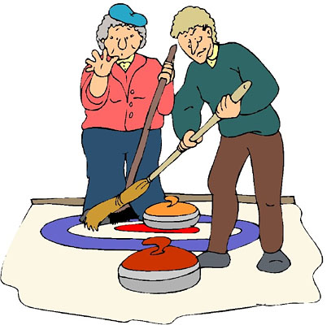
An Introduction to Spark’s Architecture
Spark Architecture Concepts: Recap
Shuffling is the process of rearranging data within a cluster between stages
Triggered by “wide” operations:
Re-partitioning
ByKey operations (except counting)
Joins, the worse being cross joins
Storting
Distinct
GroupBy

Slide 109

An Introduction to Spark’s Architecture
Spark Architecture Concepts: Recap
Try to group wide transformations together for the best automatic optimization
Aim for: narrow, narrow, wide, wide, wide, narrow
Avoid: narrow, wide, narrow, wide, narrow, wide
One of the most significant, yet often unavoidable, cause of performance degradation
Just because it’s slow, it doesn’t mean that it’s bad (don’t polish the cannon ball)

Slide 110


